Slide 1
Level 6 Group 5
Jay Pointer, Dalton Kirk and Ashley Burton

Slide 2
Log Line- A social competitive snack game with tactical immersion.
Demographic- 18-24 Males
Goal-

Slide 3
Player Experience and Fun
Hard Fun
Links into Fierro
Player
Player Experience

Slide 4
Mechanics - Sails

Slide 5
Mechanics – Birds

Slide 6
Mechanics – Fire

Slide 7
Mechanics – Kraken!

Slide 8
Progression System
Players progress through the game by exploring zones
Zones will get tougher and require stronger/more ships
Completing an exploration rewards the player with experience
This experience will increase their Rank

Slide 9
Social Competition
Facebook integration
See your friends rank and compete
Post what you have unlocked (zones, cosmetics)

Slide 10
Rewards
Rewards will encourage players to keep playing our game
Rewards will make players feel better about playing our game
Getting rewards creates investment

Slide 11
How We Will Reward – New Sails
Fixed time reward – new random sail every 7th day you play the game
Cosmetic item that allows customisation
Creates daily habit of launching game (Hook model, Nir Eyal)
Peacock effect – Look at me now

Slide 12
How We Will Reward - Chests
A chest will be awarded to a player for completing an exploration.
Chests contain variable rewards specific to that zone.
Possible rewards from chests include: Unique sails, gold/resources, unique pets or whatever

Slide 13
How We Will Reward - Skill
Skill reward - Bonus experience for playing well
Why? - Increase feeling of mastery, makes player feel good
Combos – E.g. tapping on birds in a row without missing one
Perfects – not making a single mistake. E.g. Not breaking the sails once on an exploration

Slide 14
Immersion
Tactical Immersion
In game where the skill required to complete a level brings a player into the game
Could be phrased as “In the Zone”

Slide 15
Tension and Release
Tension through each level
Increase overtime.
Keeping the player engaged.
Release once level is completed.
Release and Reward throughout the game
Rewards come with release.
Reward player with help on mechanics and score.
Repeating difficulty curve to keep the game interesting but accessible to players of all skill levels.
Learn, practice, master loop.
New mechanic
Hard
Tension
Time
Easy
Levels

Slide 16
Mobile Accessibility
UI
Size of everything on the screen
Art Style
Input
Short Levels

Slide 17


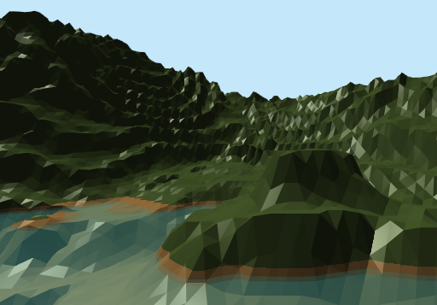
Art Style
Low poly 3d Art Style
Pastel Colours

Slide 18
Questions?

